Slide 1
Personal Website with GitLab Pages
Software Studio 軟體設計與實驗
Hung-Kuo Chu
Department of Computer Science
National Tsing Hua University
CS2410

Slide 2
Layout
What are we going to do?
TODO
Starting up
Bootstrap Components
Photo Gallery – Grid
YouTube <iframe> – Media Query
Deploy Websites with Gitlab
Grading Policy

Slide 3
What are we going to do?
Make a website from scratch
Make a responsive website (RWD)
Use Bootstrap components
Deploy a website with GitLab

Slide 4
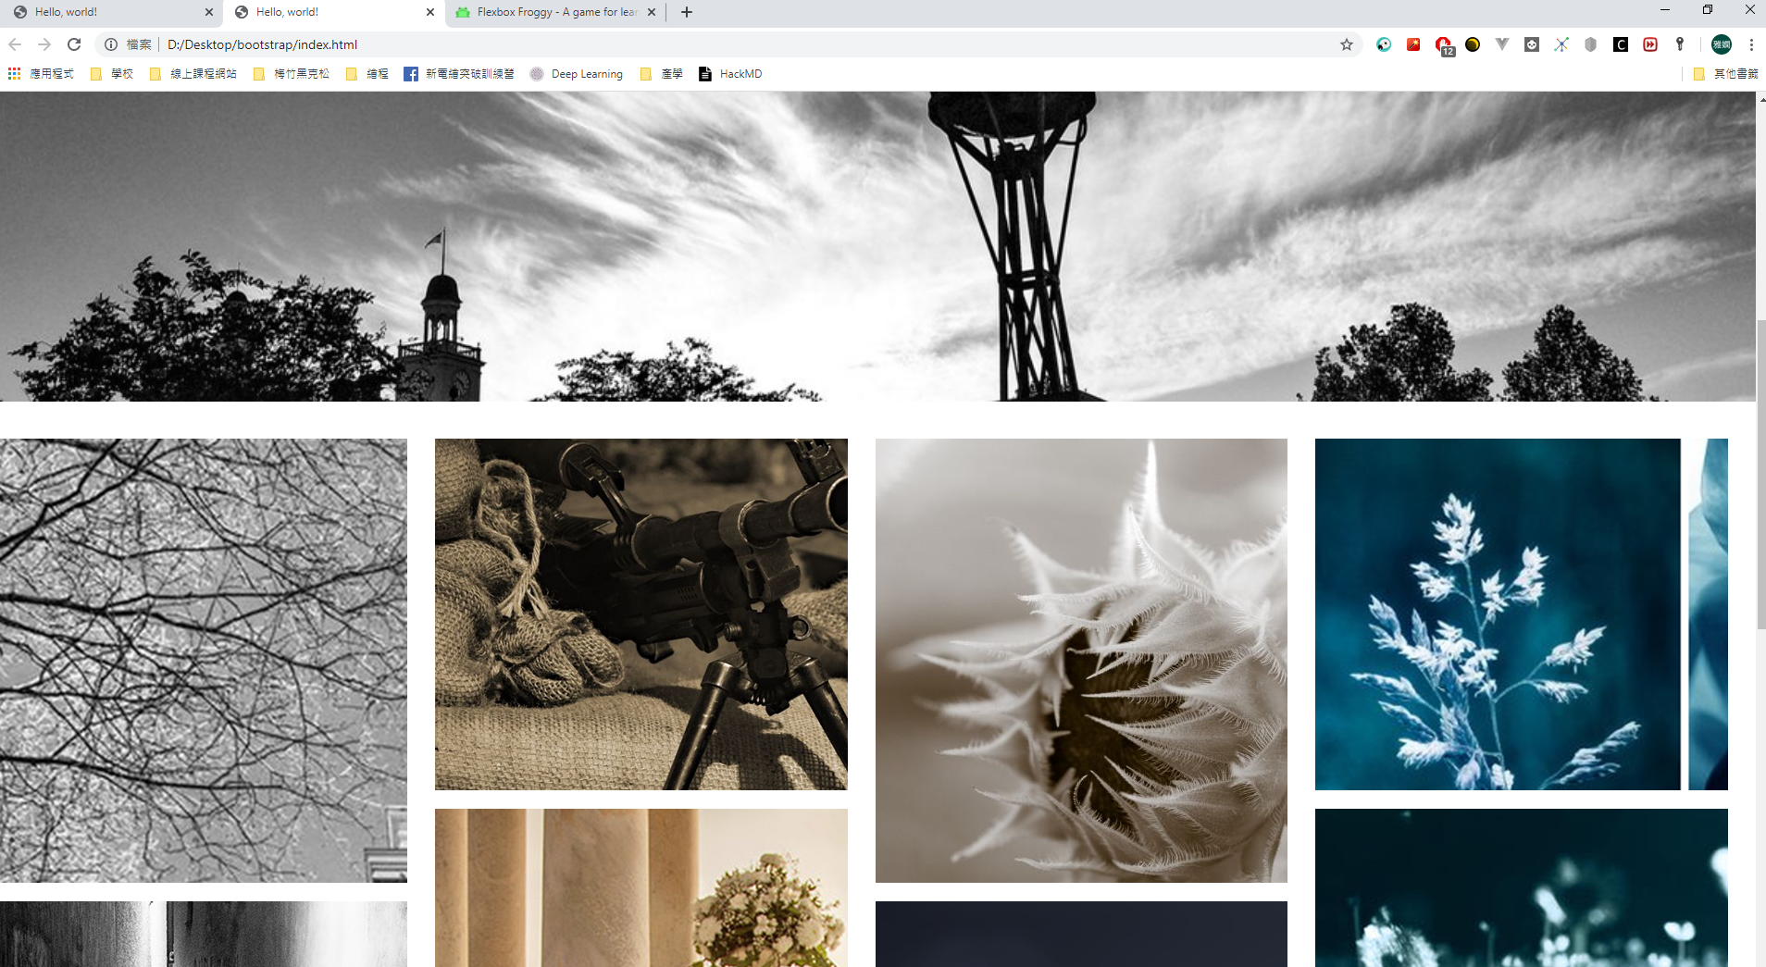
What are we going to do?
Checkout the Website!
https://rpkq0512.gitlab.io/

Slide 5
Goal
Fork TA’s template repo
https://gitlab.com/software_studio_2020/student/lab03-personal-website-with-gitlab-pages
Add 3 Bootstrap components
Add a photo gallery
Add YouTube <iframe>

Slide 6
Goal
Remove fork relation and set project visibility to public.
Deploy your page to Gitlab and change it to user website
Do not use any template from Internet or you will get zero grade
Deadline: 2020/03/22 17:20 (commit time)

Slide 7
Layout
What are we going to do?
TODO
Starting up
Bootstrap Components
Photo Gallery – Grid
YouTube <iframe> – Media Query
Deploy Websites with Gitlab
Grading Policy

Slide 8
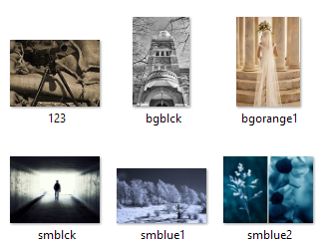
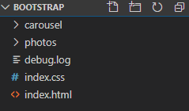
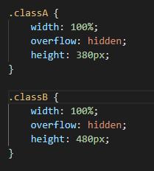
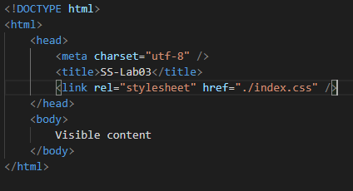
Starting up - Files

Slide 9
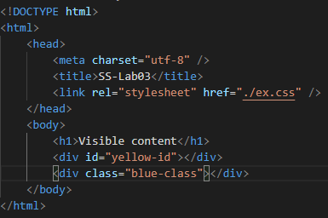
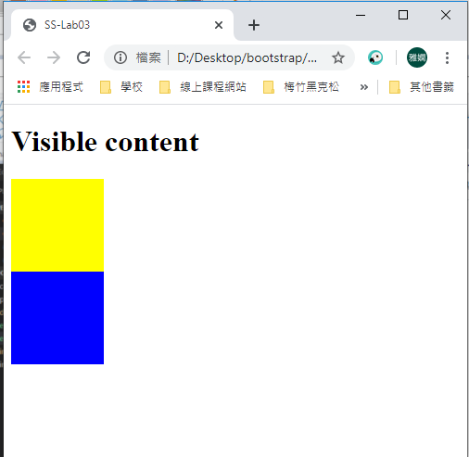
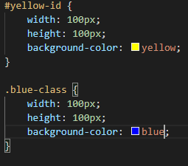
Starting up - CSS Class & Id
ex.html
ex.css
#id-name
.class-name

Slide 10
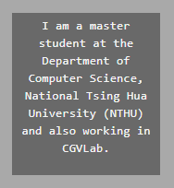
Starting up -The <div> Element
A <div> element is important to website layouts
<div> often use with CSS style
When used with CSS, the <div> element can be used to style blocks of content

Slide 11
Layout
What are we going to do?
TODO
Starting up
Bootstrap Components
Photo Gallery – Grid
YouTube <iframe> – Media Query
Deploy Websites with Gitlab
Grading Policy

Slide 12
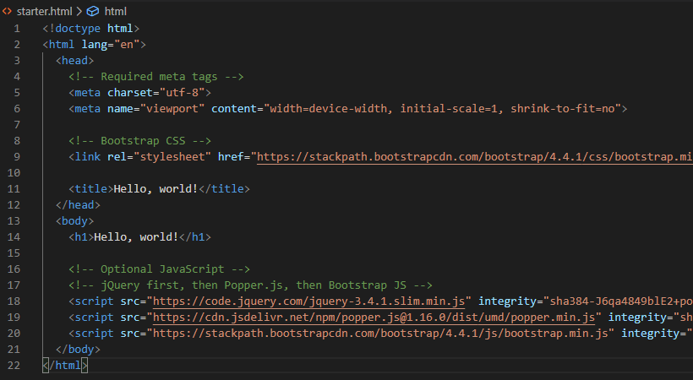
Bootstrap Component
Fork Bootstrap starter template from TA’s repo!

Slide 13
Bootstrap Component
Let’s start building our website!
Bootstrap is an extremely popular front-end framework for building responsive website, providing us with a bunch of front-end components.
Let us try adding a navbar to our website.

Slide 14
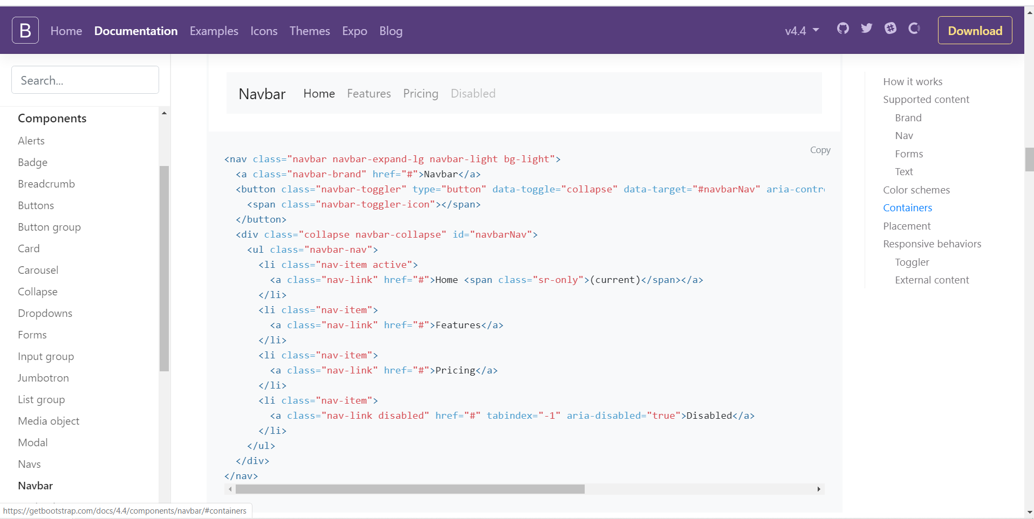
Bootstrap Component
Bootstrap Documentation - navbar
Copy the code!

Slide 15
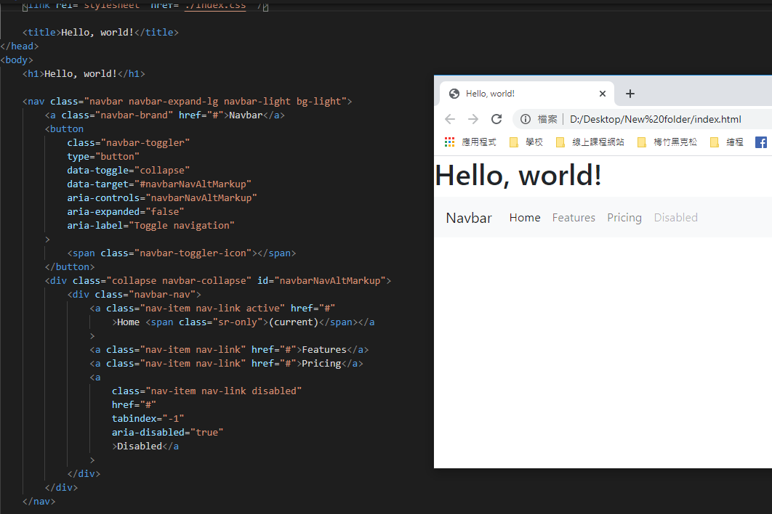
Bootstrap Component
Paste the code
Navbar is added!

Slide 16
Bootstrap Component
Choose 3 Bootstrap components from below and add them to your website!
Button
Card
Carousel
Media object
Pagination
Progress
Spinners
Toasts

Slide 17
Layout
What are we going to do?
TODO
Starting up
Bootstrap Components
Photo Gallery – Grid
YouTube <iframe> – Media Query
Deploy Websites with Gitlab
Grading Policy

Slide 18



Photo Gallery – Grid
width: 1200px
width: 900px
width: 650px

Slide 19
Photo Gallery – Grid
Divide the page into columns with Grid.
12
col-lg-3
When the screen is ‘large’, we divide the gallery into 4 columns.
3
3
3
3
Grid Tutorial
https://getbootstrap.com/docs/4.4/layout/grid/

Slide 20
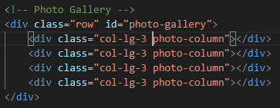
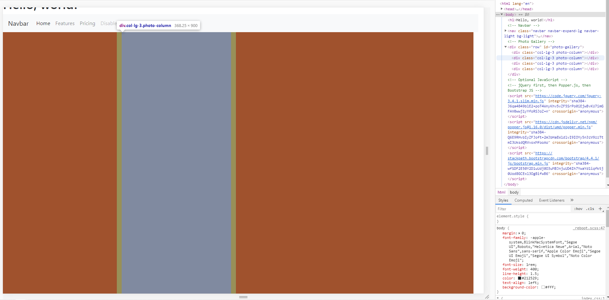
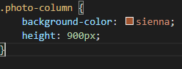
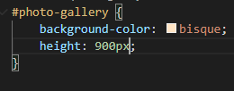
Photo Gallery – Grid
Divide a <div> into four columns.
Index.html
Bootstrap class
Index.css

Slide 21
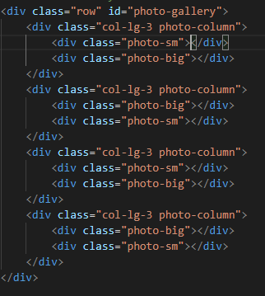
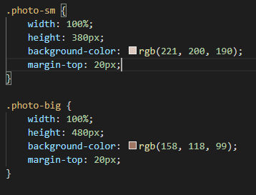
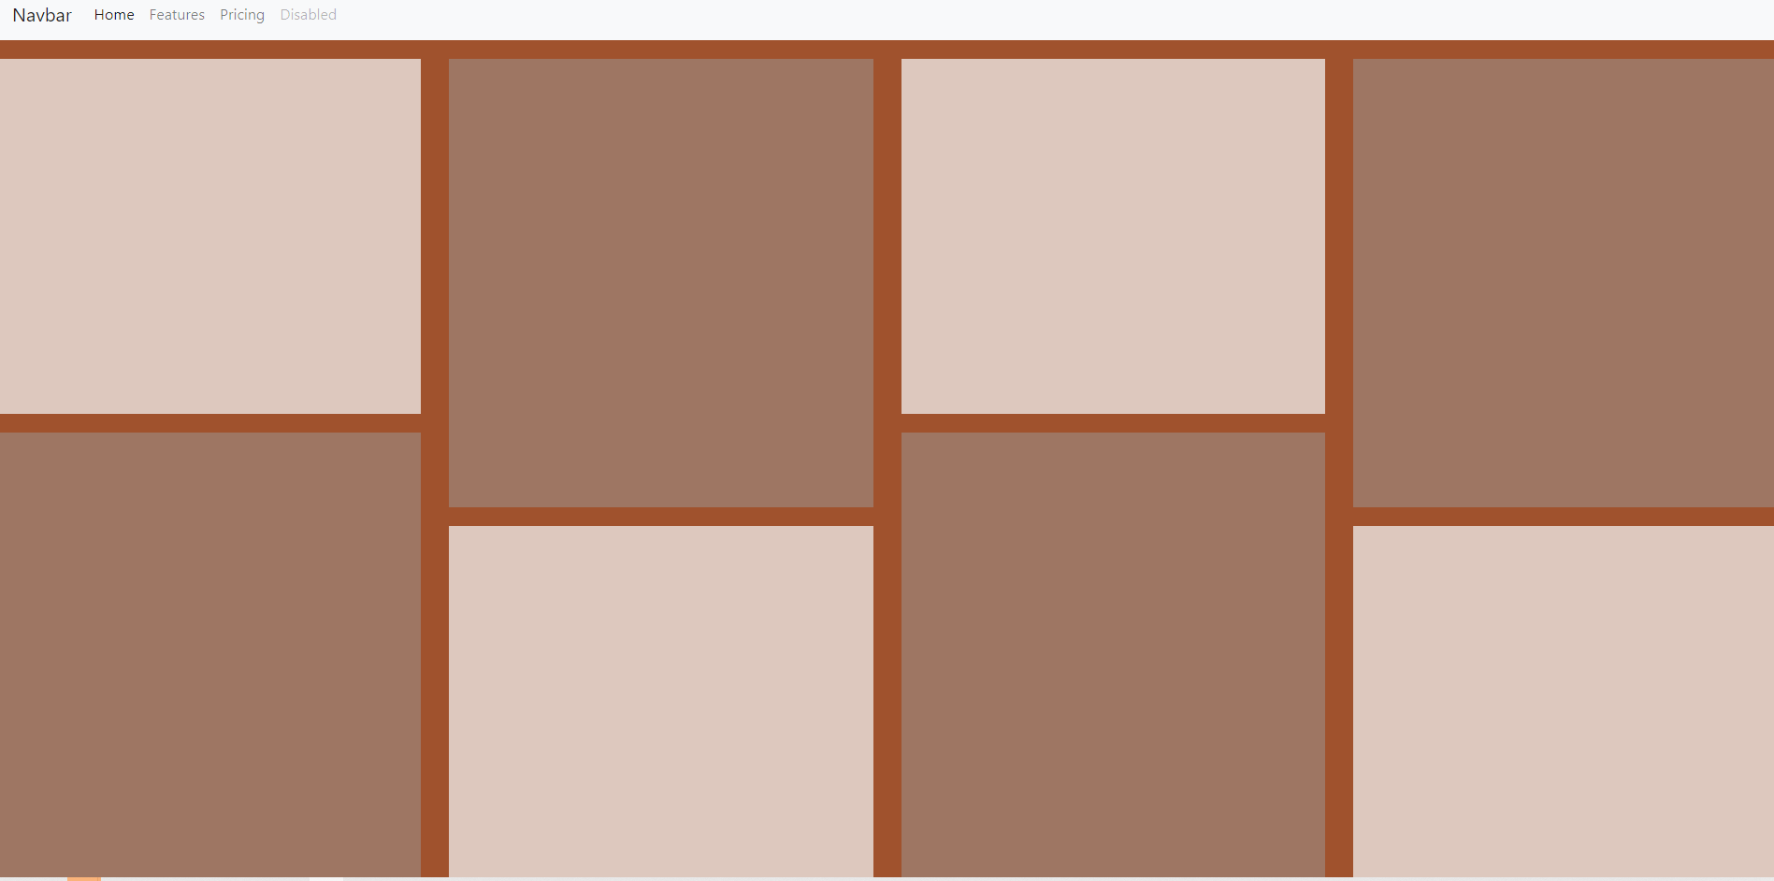
Photo Gallery – Grid
Divide each columns to 2 parts.
Index.html
Index.css

Slide 22
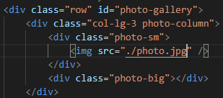
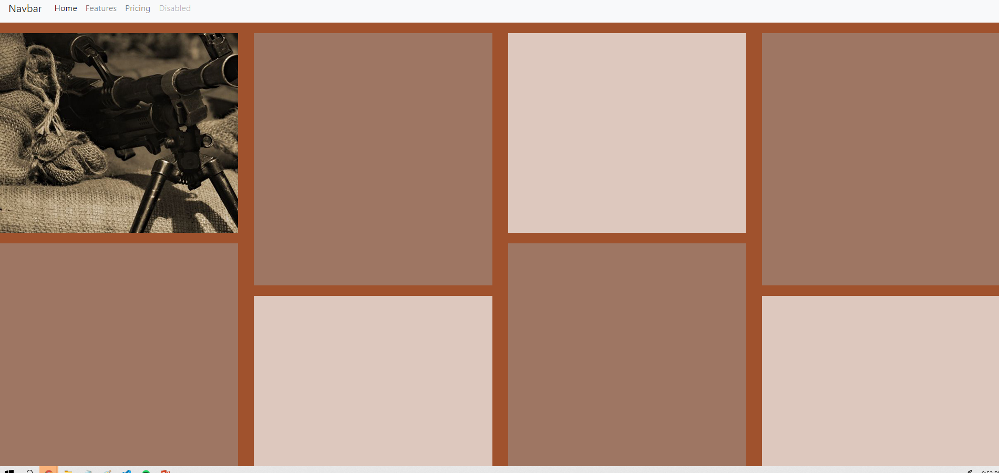
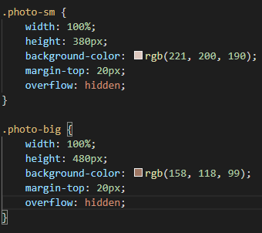
Photo Gallery – Grid
Add an image.
Index.html
Index.css
If not added, the photo will overflow the border

Slide 23
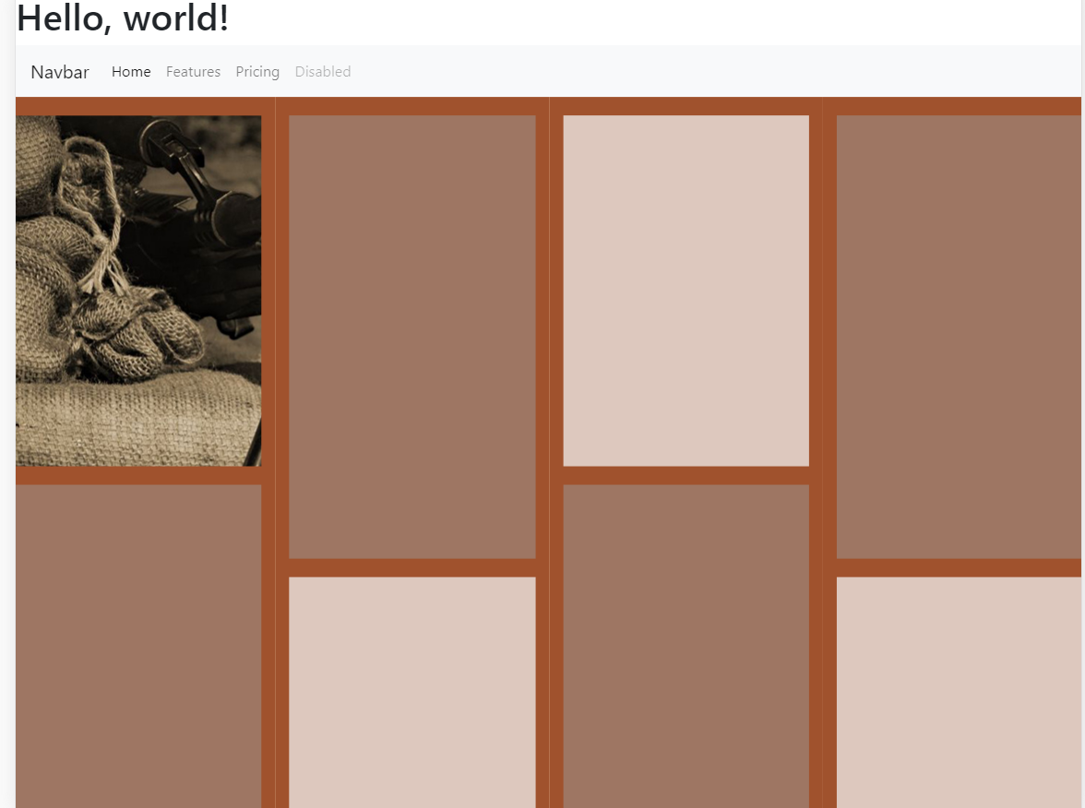
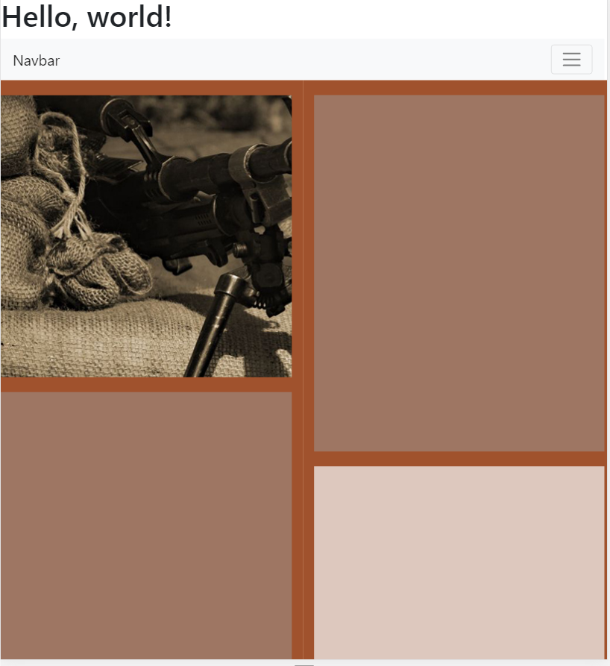
Photo Gallery – Grid
The gallery becomes single-columned if the screen width is smaller than 911px(large screen size).
Can we make it 2-columned?
?

Slide 24
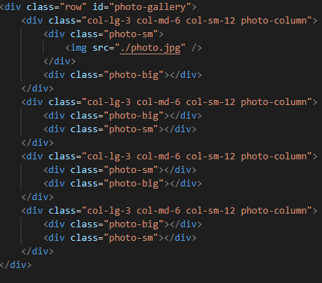
Photo Gallery – Grid
Add col-md-6 and col-sm-12

Slide 25
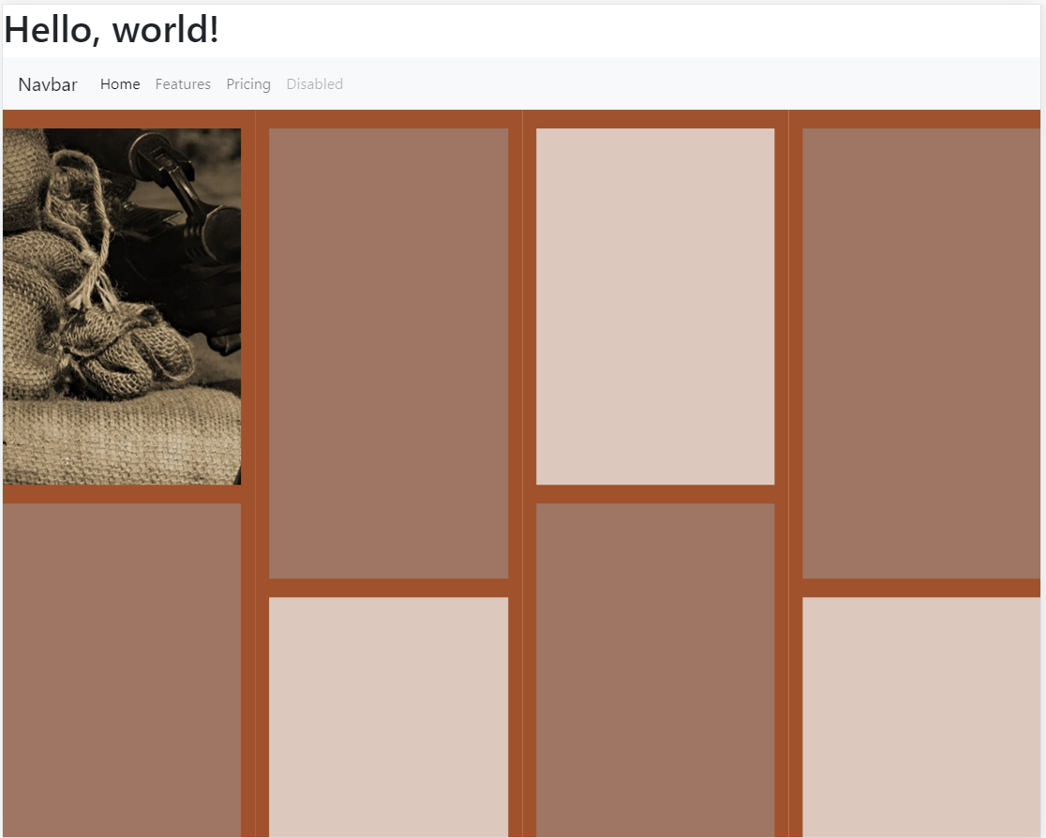


Photo Gallery - Grid
Now we get a responsive webpage!

Slide 26
Photo Gallery - Grid
Also, it is strongly recommended to learn Flex system, which is another layout system.
Flexbox Froggy:
https://flexboxfroggy.com/

Slide 27
Layout
What are we going to do?
TODO
Starting up
Bootstrap Components
Photo Gallery – Grid
YouTube <iframe> – Media Query
Deploy Websites with Gitlab
Grading Policy

Slide 28
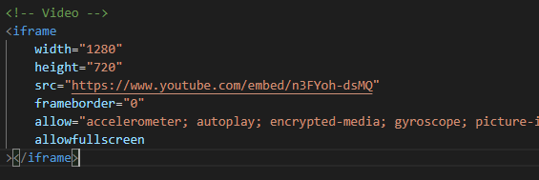
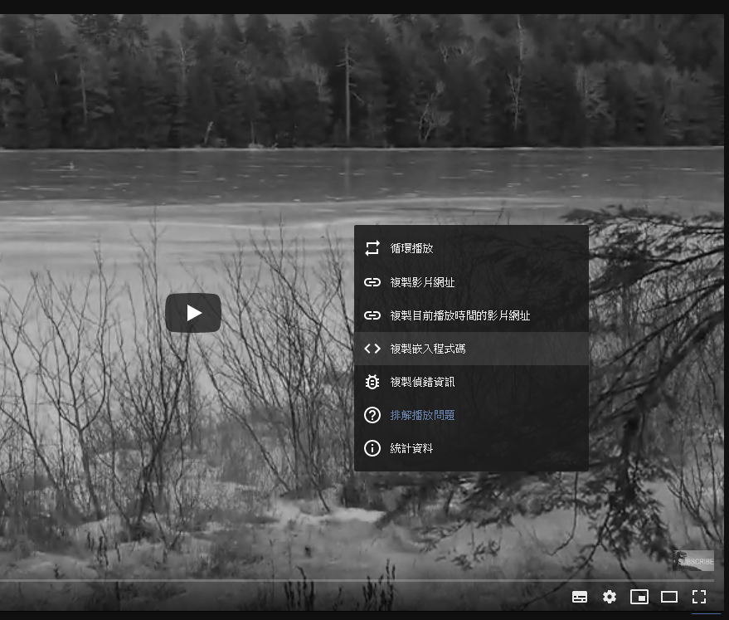
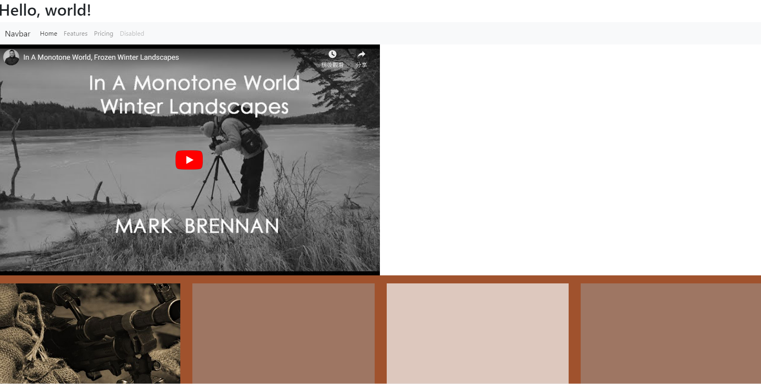
YouTube <iframe> – Media Query
Adding a YouTube video to our webpage is extremely easy!

Slide 29

YouTube <iframe> – Media Query
But how do we make it responsive?
The left part of the video is hidden ☹

Slide 30
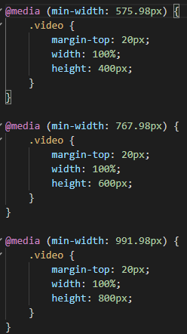
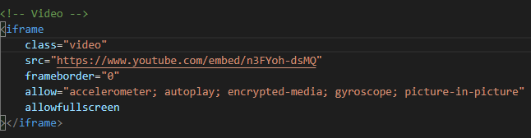
YouTube <iframe> – Media Query
But how do we make it responsive?
Index.css
Index.html
Remove ‘width’ & ‘height’, add ‘class’

Slide 31

YouTube <iframe> – Media Query
Now it works perfectly!
Try to add a responsive YouTube video to your page!

Slide 32
Layout
What are we going to do?
TODO
Starting up
Bootstrap Components
Photo Gallery – Grid
YouTube <iframe> – Media Query
Deploy Websites with Gitlab
Grading Policy

Slide 33
Deploy Websites with Gitlab
To make the website visible to everyone
Remove the fork relation at setting > General > Advanced
Set the project visibility to public at setting > General > Visibility

Slide 34
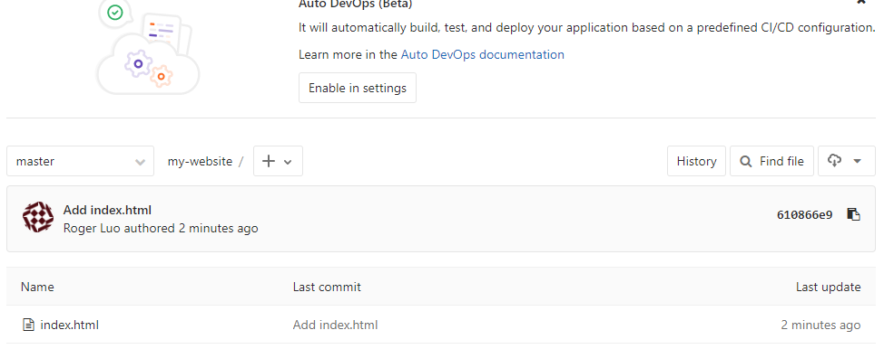
Deploy Websites with Gitlab
Commit your change and push it to remote repo

Slide 35
Deploy Websites with Gitlab - GitLab CI/CD
GitLab offers a continuous integration service. If you add a .gitlab-ci.yml file to the root directory of your repository, and configure your GitLab project to use a Runner, then each commit or push, triggers your CI pipeline
More Information: https://about.gitlab.com/features/gitlab-ci-cd/

Slide 36
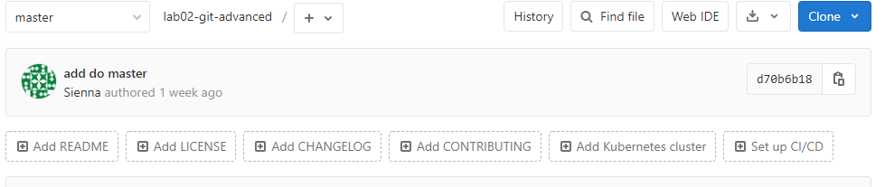
Deploy Websites with Gitlab - Setting Up GitLab CI/CD

Slide 37
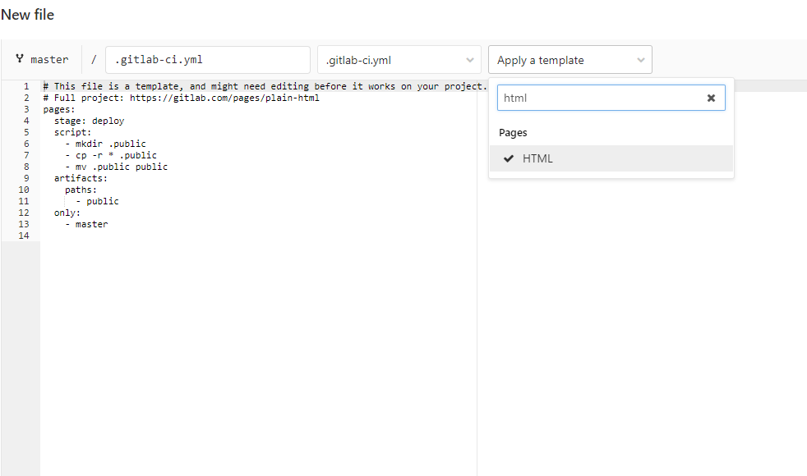
Deploy Websites with Gitlab - Setting Up GitLab CI/CD
select HTML template

Slide 38
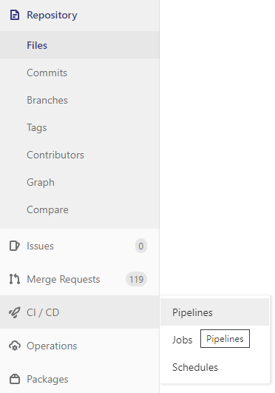
Deploy Websites with Gitlab - Setting Up GitLab CI/CD
Go to CI/CD > Pipelines from navigation bar on the left

Slide 39
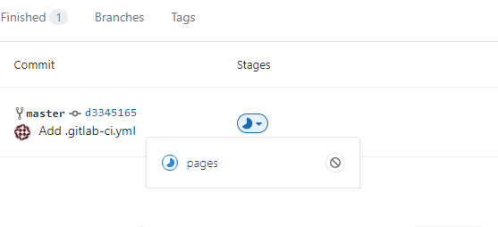
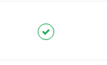
Deploy Websites with Gitlab - Pipeline
Click the button blow and get into pages to see the pipeline progress
1.
2.
Wait until it becomes like this

Slide 40
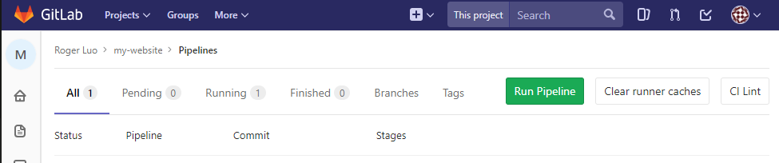
Deploy Websites with Gitlab - Pipeline
You can run pipeline again by clicking the Run Pipeline button on Pipeline page, if you encounter an error in previous steps.

Slide 41
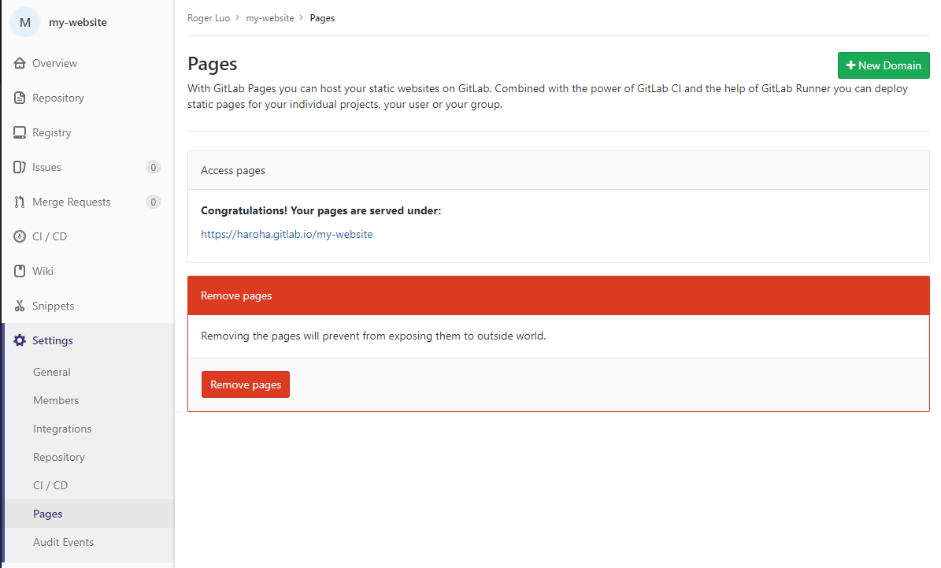
Deploy Websites with Gitlab - Visit Your Website
Now you can go to the Setting > Pages and get your website link
Notes:
注意這個page只有用我們的帳號才看得見，因為是算在我們的 project 裡
如果未來有自己的 page，要從 setting -> general ->visibility 設定成 public

Slide 42
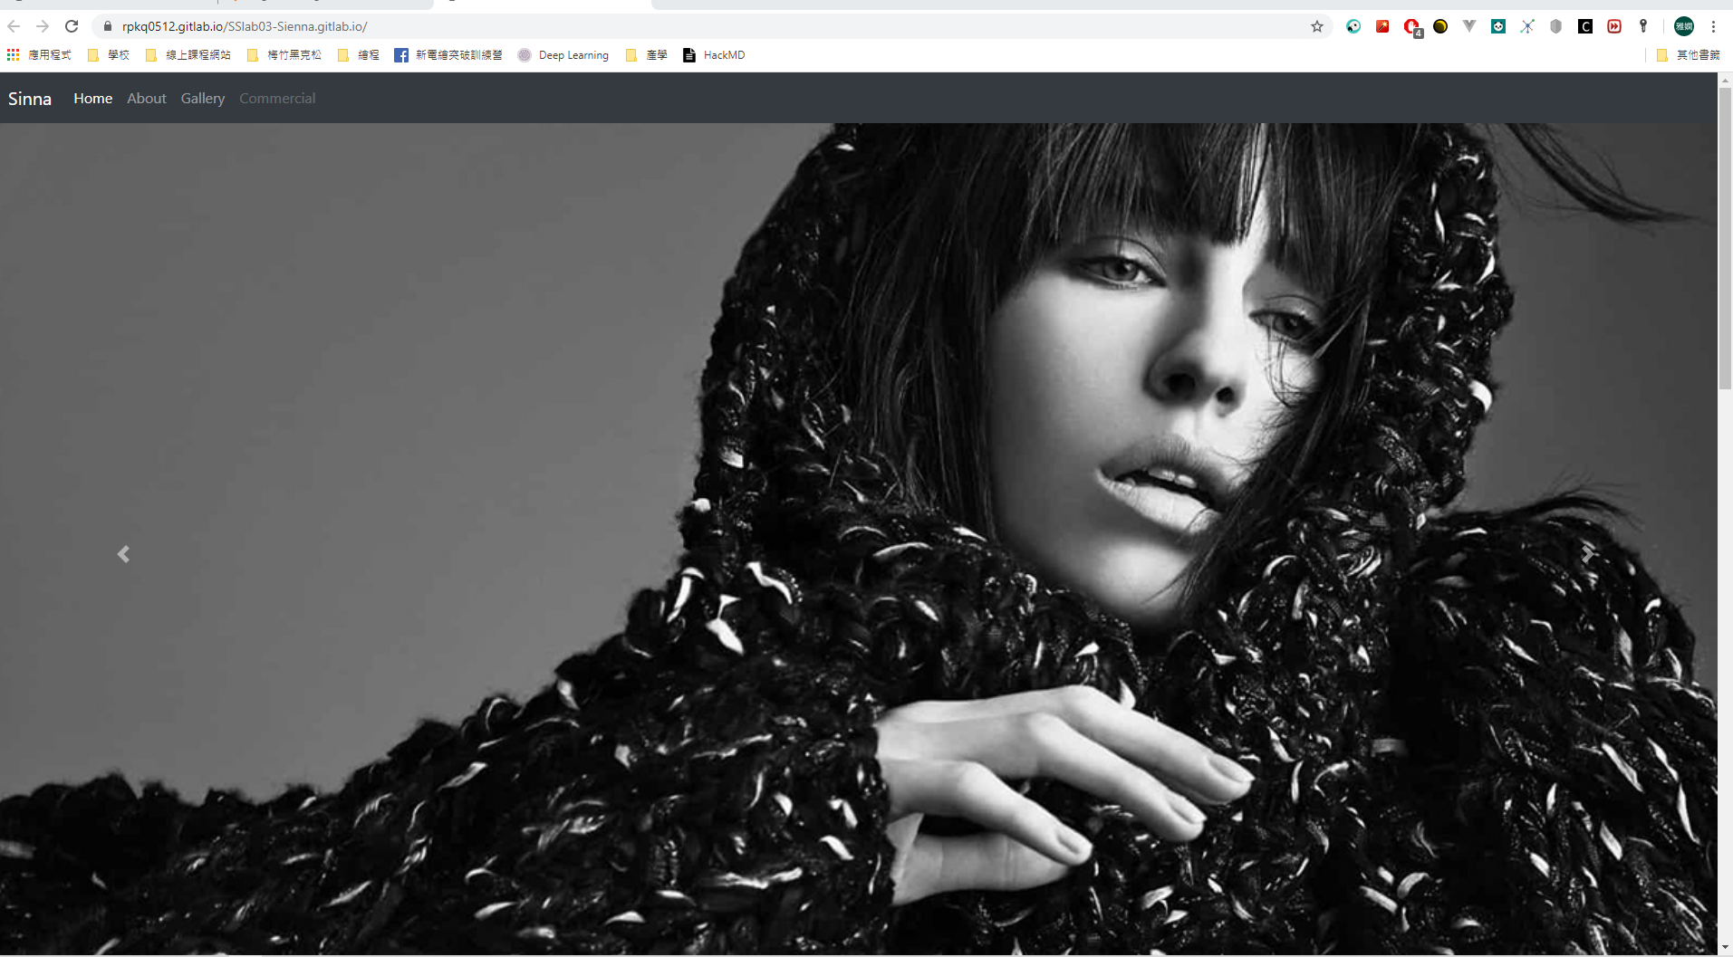
Deploy Websites with Gitlab - Visit Your Website

Slide 43
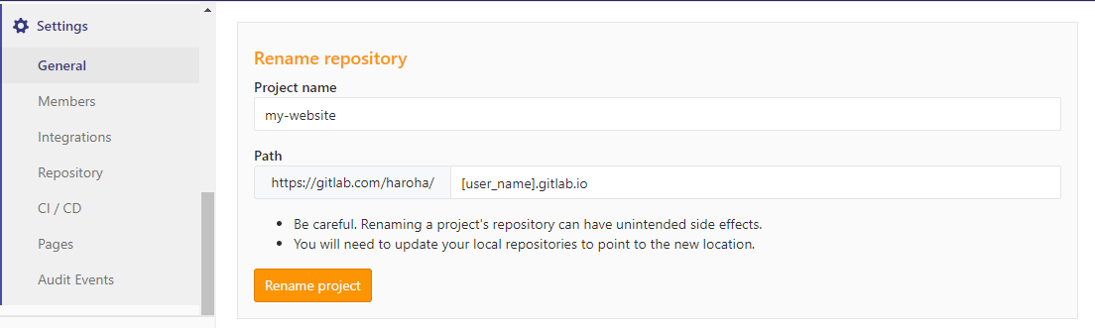
Change to User Website
Go to Setting > General > Advanced
Find the Advanced settings and Expand it
Rename your repository Path to [user_name (e.g. haroha)].gitlab.io

Slide 44
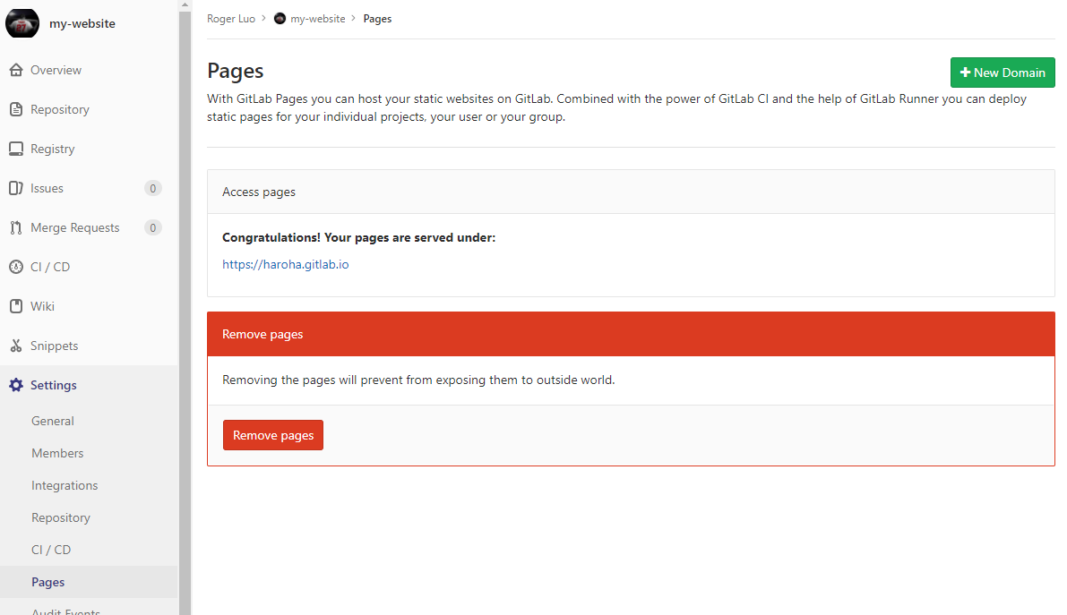
Change to User Website

Slide 45
Change to User Website
Notices that if you change your repository path, your local repository remote should change too
If you don't change your local repository remote, you won't get access to pull your commit to the remote repository

Slide 46
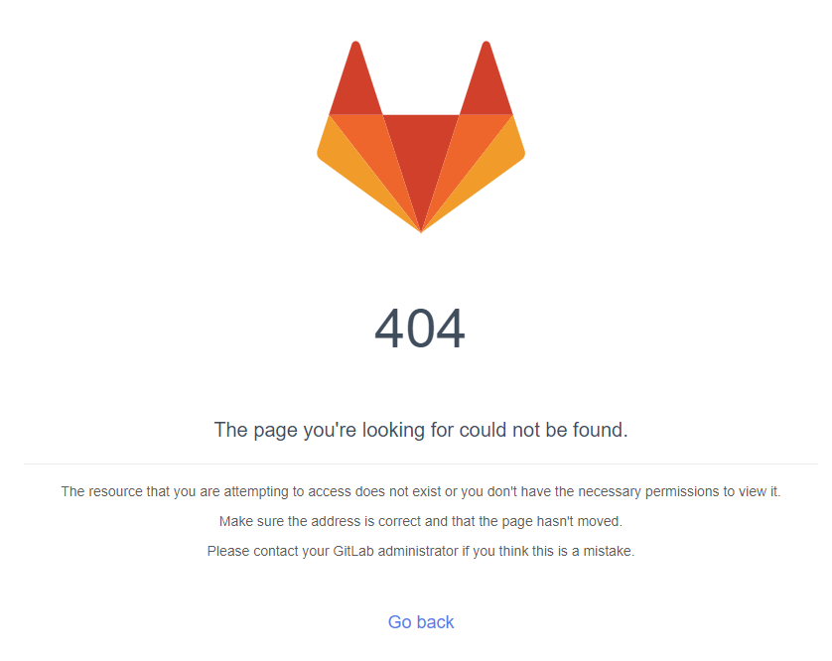
GitLab Page
If you make change to your GitLab page and you see this, sometimes you just need to wait.

Slide 47
Layout
What are we going to do?
TODO
Starting up
Bootstrap Components
Photo Gallery – Grid
YouTube <iframe> – Media Query
Deploy Websites with Gitlab
Grading Policy

Slide 48
Grading Policy
Basic (Page deployment) 20%
3 Bootstrap Components 20%
Photo Gallery
At least one photo 5%
Basic Layout 20%
RWD Layout (3 layouts) 5%
YouTube <iframe>
<iframe> 5%
Responsive with media query 25%
Leave page URL under the FB post.
Evaluation is based on the deployed webpage.
If TAs cannot find your page, you will get 0 point.

Slide 49
Bootstrap Components
Button
Card
Carousel
Media object
Pagination
Progress
Spinners
Toasts

